Slide 1


KPI-ML Logos
Source

Slide 2



KPI ML

Slide 5
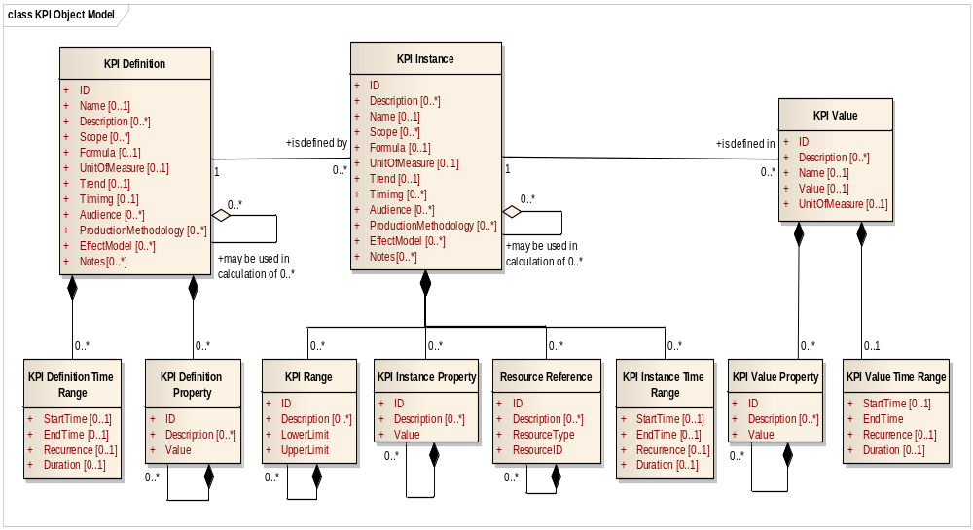

Slide 6





Name of an element or element type
Indicates fixed order of elements
Indicates elements
Indicates 1 instance only
Indicates 1 to many instances
Indicates 0 or 1 instance only
Indicates 0 to many instances
Indicates selection of alternatives
Indicates contained elements or attributes
Indicates no contained elements or attributes

Slide 7
GET Equipment
Information Provider
Application Identification Area
Information
User
Data Area
VERB = GET
GET
Local
processing
SHOW Equipment
Noun = Equipment
ID= “A*”
Application Identification Area
Data Area
VERB = SHOW
Noun = Equipment
ID= “ABC”
Description = “Simple equipment”
Equipment Property
ID = “Throughput”
Value = “200”
Value Unit of Measure = “PPM”
Description = “Throughput as parts
per minute”
…
Noun = Equipment
ID= “A11862”
Description = “Complex equipment”
Equipment Property
ID = “Throughput”
Value = “2000”
Value Unit of Measure = “PPM”
Description = “Throughput as parts
per minute”
…
SHOW

Slide 8
Information
Requestor
Information
Provider
GetKPIDefinition
ShowKPIDefinition
Information
Sender
Information
Receiver
ProcessKPIValue
AcknowledgeKPIValue
Information
Sender
Information
Receiver
ChangeKPIInstance
RespondKPIInstance
Information
Sender
Information
Receiver
CancelKPIInstance
ConfirmBOD

Slide 9
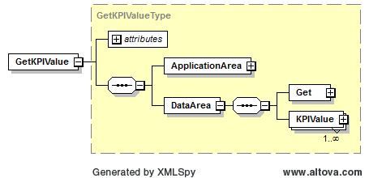

Slide 10
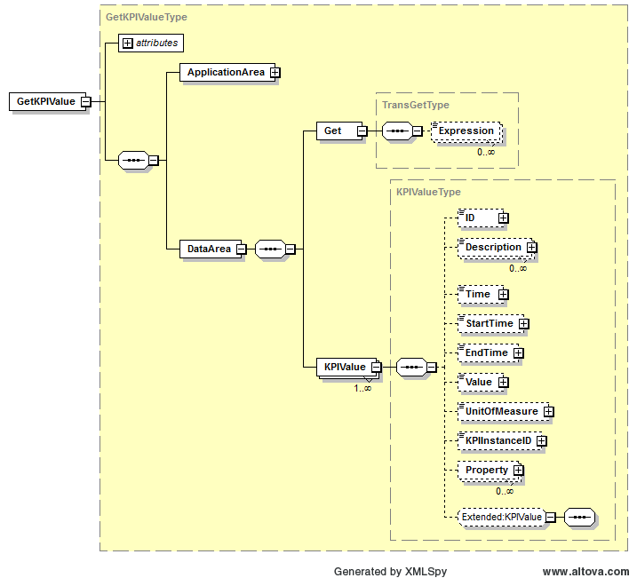
Value of element determines what is returned
Value of element determines what is returned
Value of element determines what is returned

Slide 11
Information
Publisher
Information
Subscriber
SyncKPIInstance (Add)
ConfirmBOD
Information
Publisher
Information
Subscriber
SyncKPIValue (Change)
ConfirmBOD
Information
Publisher
Information
Subscriber
SyncKPIDefinition (Delete)
ConfirmBOD

Slide 12
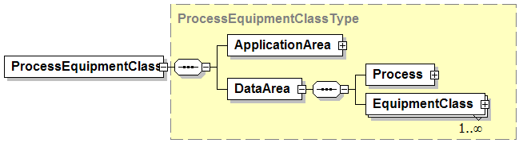
Combined Verb and Object Element Name
Verb Specific Area
<Verb><Object>
<Verb>
<Object>
Object Specific Area

Slide 13
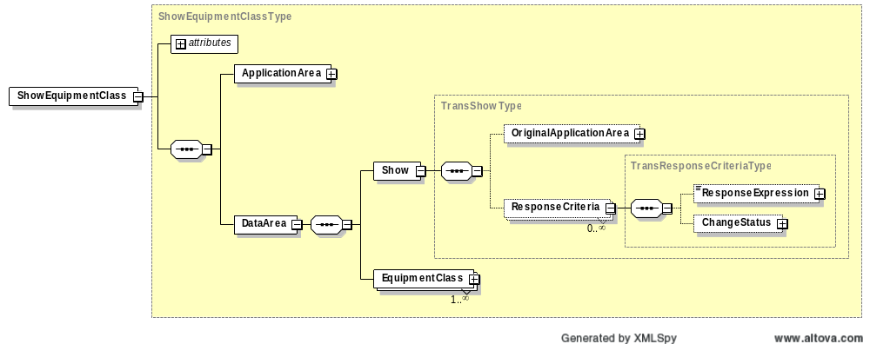
Contains required “actionCode” attribute of Accepted or Rejected
Contains optional addition reasons for return status

Slide 14
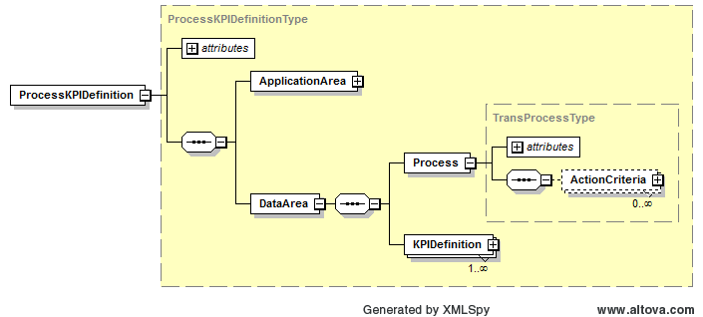
Contains optional “acknowledgeCode” attribute

Slide 15
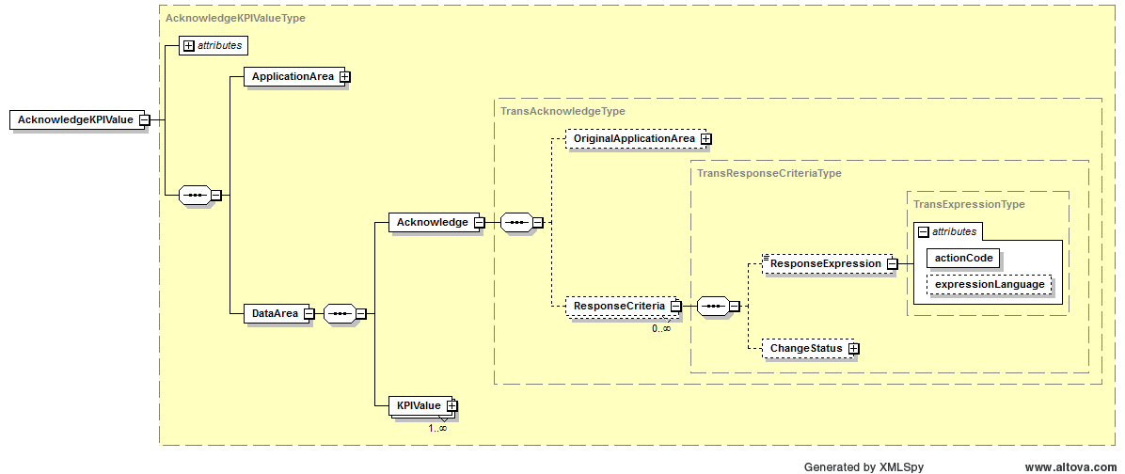
Contains required “actionCode” attribute

Slide 16
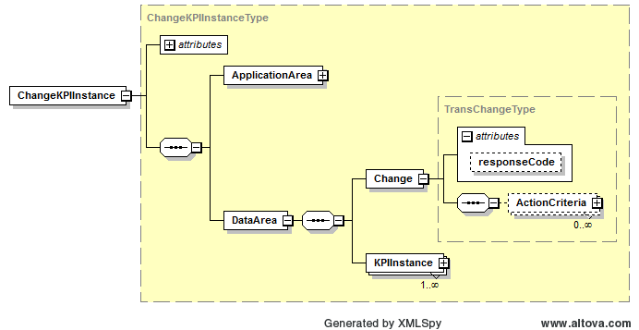
Contains optional “responseCode” attribute

Slide 17
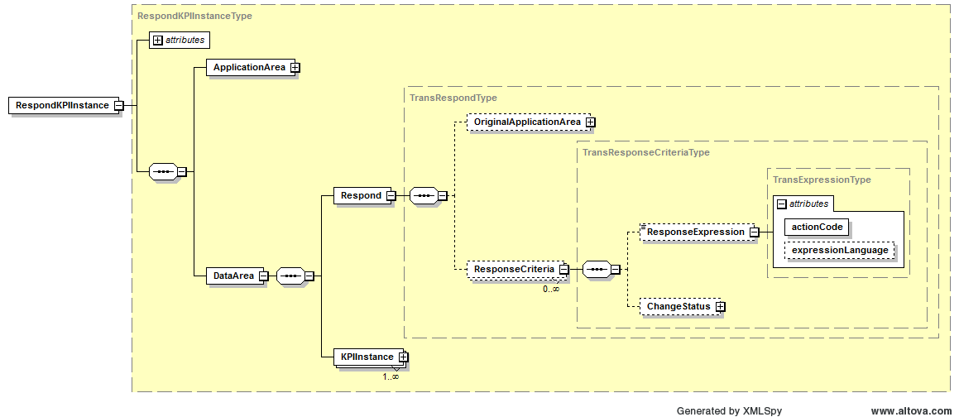
Contains required “actionCode” attribute

Slide 18
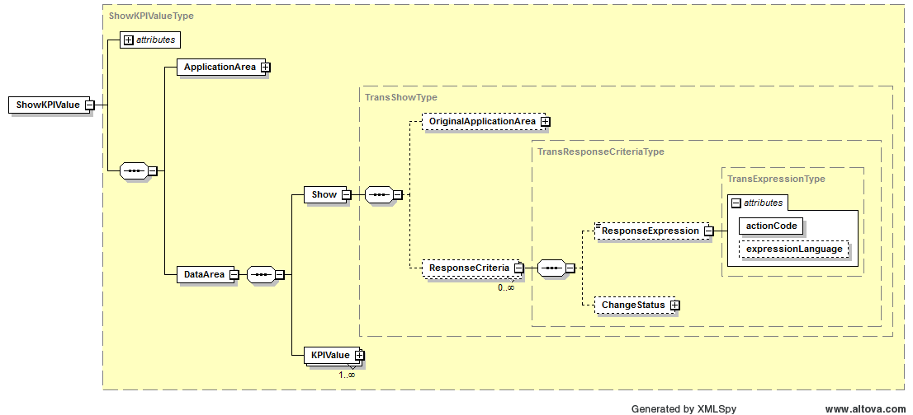
Contains required “actionCode” attribute of Accepted or Rejected

Slide 19
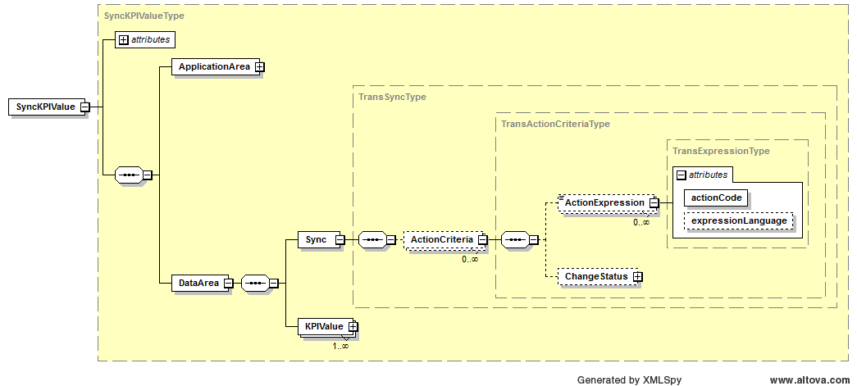
Contains required “actionCode” attribute of Add, Change, or Delete

Slide 20
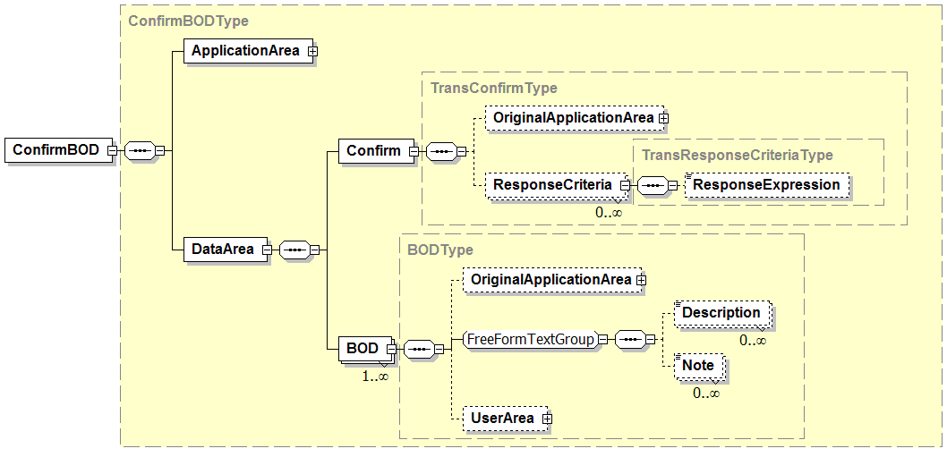
Contains required “actionCode” attribute of Accepted or Rejected
Contains additional information provided by the sender to assist in the handling of any error condition.

Slide 21
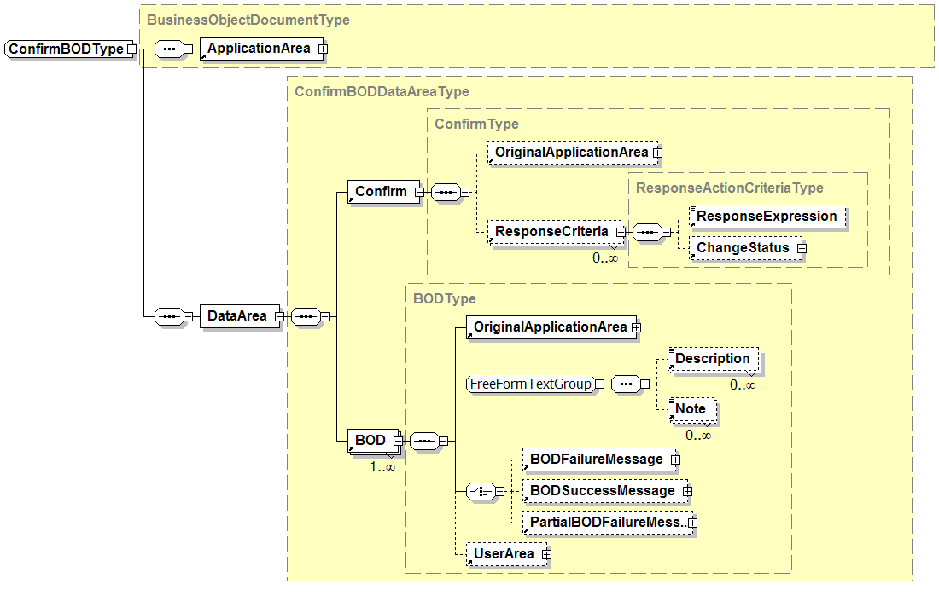
Not defined in B2MML

Slide 22
Production Planning & Scheduling Scenario
Level 4
PLM
Level 4
Asset Mgt
Level 4
Production Planning & Capacity Analysis
Level 4
Inventory Mgt
SHOW Equipment
SHOW Product Definition
PROCESS Production Capability
PROCESS Production Schedule
PROCESS Production Performance
GET Product Definition
GET Equipment
PROCESS MaterialSubLot
Level 3
Product Definition Management
Level 3
Production Resource Mgt
Level 3
Detailed Scheduling
Level 3
Production Tracking
Communication within Levels 3 or 4 are not shown since they are not in the scope of ISA-95 Parts 1 and 2

Slide 23
Business Process Scenario #1a
PUSH MODEL – Production Schedule / Production Performance
ERP
Level 4
Production Scheduling
MOM
Level 3
PROCESS – Production Schedule
PROCESS – Production Performance
Some work
complete
PROCESS* – Production Performance
All work finished
Scenario assumptions:
1. ERP send production schedule to MOM for processing
2. MOM (Manufacturing Operations Management) sends production performance to ERP for processing
* Message contains a FINAL flag to indicate that the message is the final production performance for the associated production schedule.

Slide 24
Business Process Scenario #3a
PULL MODEL – Production Schedule / Production Performance
ERP
Level 4
GET – Production Schedule
MOM
Level 3
SHOW – Production Schedule
Some work
complete
GET – Production Performance~
SHOW – Production Performance
All work finished
GET – Production Performance~
SHOW* – Production Performance
Scenario assumptions:
1. MOM requests production schedule from ERP
2. ERP requests production performance from MOM
~ The GET production performance message contains an identification of a production schedule (Production Performance / Production Schedule ID)
* The final SHOW production performance message contains a flag to indicate that the message is the final production performance for the associated production schedule.

Slide 25
Business Process Scenario #1a
PUBLISH MODEL – Production Schedule / Production Performance
ERP
Level 4
Production Scheduling
MOM
Level 3
SYNC ADD – Production Schedule
SYNC ADD – Production Performance
Some work
complete
SYNC CHANGE* – Production Performance
All work finished
Scenario assumptions:
1. MOM subscribes to production schedules.
2. ERP subscribes to production performances.
3. ERP publishes production schedule.
4. MOM publishes initial production performance with a SYNC ADD message.
5. MOM publishes subsequent production performances for the schedule with SYNC CHANGE messages.
* Message contains a FINAL flag to indicate that the message is the final production performance for the associated production schedule.

Slide 26
Business Process Scenario #1b
PUSH MODEL – Production Schedule Changes
ERP
Level 4
Production Scheduling
PROCESS – Production Schedule
MOM
Level 3
PROCESS – Production Performance
Some work
complete
Schedule
changes
CHANGE – Production Schedule
PROCESS – Production Performance
Some more
work complete
PROCESS* – Production Performance
All work finished
Scenario assumptions:
1. ERP sends production schedule to MOM for processing
2. MOM sends production performance to ERP for processing
3. ERP makes change to schedule and sends to MOM for processing
* Message contains a FINAL flag to indicate that the message is the final production performance for the associated production schedule.

Slide 27
Business Process Scenario #1b
PUBLISH MODEL – Production Schedule Changes
ERP
Level 4
Production Scheduling
SYNC ADD – Production Schedule
MOM
Level 3
SYNC ADD – Production Performance
Some work
complete
Schedule
changes
SYNC CHANGE – Production Schedule
SYNC CHANGE – Production Performance
Some more
work complete
SYNC CHANGE* – Production Performance
All work finished
Scenario assumptions:
1. MOM subscribes to production schedules.
2. ERP subscribes to production performances.
3. ERP publishes production schedule.
4. MOM publishes initial production performance with a SYNC ADD message.
5. ERP changes the schedule based on initial work done and republished with a SYNC CHANGE
6. MOM publishes subsequent production performances for the schedule with SYNC CHANGE messages.
* Message contains a FINAL flag to indicate that the message is the final production performance for the associated production schedule.

Slide 28
Business Process Scenario #1b
PUBLISH MODEL – Production Schedule Changes
ERP
Level 4
Production Scheduling
SYNC ADD – Production Schedule
MOM
Level 3
SYNC ADD – Production Performance
Some work
complete
Schedule
changes
SYNC CHANGE – Production Schedule
SYNC CHANGE – Production Performance
Some more
work complete
SYNC CHANGE* – Production Performance
All work finished
Scenario assumptions:
1. MOM subscribes to production schedules.
2. ERP subscribes to production performances.
3. ERP publishes production schedule.
4. MOM publishes initial production performance with a SYNC ADD message.
5. ERP changes schedule and republishes with SYNC CHANGE
6. MOM publishes subsequent production performances for the schedule with SYNC CHANGE messages.
* Message contains a FINAL flag to indicate that the message is the final production performance for the associated production schedule.

Slide 29
Business Process Scenario #1c
PUSH MODEL – Production Schedule Canceled
ERP
Level 4
Production Scheduling
PROCESS – Production Schedule
MOM
Level 3
Schedule
invalidated
CANCEL – Production Schedule
Scenario assumptions:
1. ERP sends production schedule to MOM for processing
2. ERP cancels schedule before actual production starts, and sends CANCEL of schedule to MOM

Slide 30
Business Process Scenario #1c
PULL and PUSH MODEL – Production Schedule Canceled
ERP
Level 4
Production Scheduling
GET – Production Schedule
MOM
Level 3
SHOW – Production Schedule
Schedule
invalidated
CANCEL – Production Schedule
Scenario assumptions:
1. MOM requests production schedule from ERP.
2. ERP cancels schedule before actual production starts, and sends CANCEL of schedule to MOM.

Slide 31
Business Process Scenario #1d
PUSH MODEL – Daily Production Performance
ERP
Level 4
MOM
Level 3
Production Tracking
PROCESS – Production Performance (May 24, 2005)
PROCESS – Production Performance (May 25, 2005)
Scenario assumptions:
1. MES sends daily production performance to ERP
2. Scope of production performance (which production lines, etc…) and timing of the publication (daily, weekly, time published) is not defined in a transaction message but is determined to in an out-of-band agreement.

Slide 32
Business Process Scenario #2d
PUBLISH/SUBSCRIBE MODEL – Daily Production Performance
ERP
Level 4
MOM
Level 3
SYNC ADD – Production Performance (May 24, 2005)
SYNC ADD – Production Performance (May 25, 2005)
Scenario assumptions:
1. ERP subscribes to daily production performance from MOM
2. MOM publishes daily production performance
3. Scope of production performance (which production lines, etc…) and timing of the publication (daily, weekly, time published) is not defined in a transaction message but is determined to in an out-of-band agreement.

Slide 33
Business Process Scenario #3d
PULL MODEL – Daily Production Performance
ERP
Level 4
MOM
Level 3
GET – Production Performance (May 24, 2005)
SHOW – Production Performance (May 24, 2005)
GET – Production Performance (May 25, 2005)
SHOW – Production Performance (May 25, 2005)
Scenario assumptions:
1. ERP requests production performance from MOM on a daily schedule

Slide 34
Business Process Scenario #1h
PUSH/PULL MODEL – Production Schedule based on Production Capability
ERP
Level 4
Production Scheduling
GET – Production Capability
MOM
Level 3
Execution
SHOW – Production Capability
PROCESS – Production Schedule
PROCESS – Production Performance
Some work
complete
PROCESS – Production Performance
Some more
work complete
PROCESS – Production Performance
All work finished
Scenario assumptions:
1. ERP requests production capability for the planning period
2. MOM sends production capability to ERP
3. ERP sends production schedule to MOM for processing
4. MOM sends production performance to ERP reflecting partial order completion
5. MOM sends production performance to ERP reflecting partial order completion
6. MOM sends production performance to ERP reflecting completion of order

Slide 35
Business Process Scenario #1h
PUBLISH and PUSH MODEL – Production Schedule based on Production Capability
ERP
Level 4
Production Scheduling
MOM
Level 3
Execution
SYNC ADD – Production Capability
SYNC ADD – Production Schedule
PROCESS – Production Performance
Some work
complete
PROCESS – Production Performance
Some more
work complete
PROCESS* – Production Performance
All work finished
Scenario assumptions:
1. ERP subscribes to production capability.
2. MOM subscribes to production schedules.
3. MOM publishes production capability on a regular schedule, e.g. every 2 days,
4. ERP generates a production schedule and publishes it.
5. MOM sends production performance to ERP reflecting partial order completion.
6. MOM sends production performance to ERP reflecting partial order completion.
7. MOM sends production performance to ERP reflecting completion of order.
* Message contains a FINAL flag to indicate that the message is the final production performance for the associated production schedule.

Slide 36
Business Process Scenario #1e
PUSH MODEL – Production Schedule / Capability Changes
ERP
Level 4
MOM
Level 3
Production Resource Management
PROCESS – Production Schedule
PROCESS – Production Capability
Schedule
changes
CHANGE – Production Schedule
Scenario assumptions:
1. ERP send production schedule to MOM for processing
2. MOM sends updated production capability to ERP for processing
3. Scope of production capability (which production lines, etc…) and timing of the publication (daily, weekly, time published) is not defined in a transaction message but is determined to in an out-of-band agreement.
4. ERP changes schedule based on new capability and sends CHANGE to MOM

Slide 37
Business Process Scenario #1f
PUSH MODEL – Material Lot added, material lot quantity changed
ERP
Level 4
MOM
Level 3
New material lot
is available
PROCESS – Material Lot (quantity = 400)
CHANGE – Material Lot (quantity = 300)
Material lot
quantity changed
CHANGE – Material Lot (quantity = 200)
Material lot
quantity changed
CHANGE – Material Lot (quantity = 0)
Material lot
quantity changed
Material lot no
longer available
CANCEL – Material Lot
Scenario assumptions:
1. Consumable material arrives at the facility and is entered into the ERP
2. ERP send material lot information to MOM for processing
3. MOM sends quantity changes in material lot to ERP as material is consumed
4. ERP sends CANCEL when material lot is no longer available

Slide 38
Business Process Scenario #1g
Mixed MODEL – Material Lot added, material lot quantity changed
ERP
Level 4
MOM
Level 3
New material lot
is available
SYNC ADD – Material Lot (quantity = 400)
CHANGE – Material Lot (quantity = 300)
Material lot
quantity changed
CHANGE – Material Lot (quantity = 200)
Material lot
quantity changed
CHANGE – Material Lot (quantity = 0)
Material lot
quantity changed
Material lot no
longer available
SYNC DELETE – Material Lot
Scenario assumptions:
1. ERP publishes material lot information, MOM subscribes
2. MOM sends quantity changes in material lot to ERP
3. ERP send SYNC DELETE when material lot is no longer available

Slide 39
New Business Process Scenario #1j
PUSH/PULL MODEL – Production Schedule Changes using Production Capability as input
ERP
Level 4
Production Scheduling
MOM
Level 3
PROCESS – Production Schedule
PROCESS – Production Performance
Some work
complete
GET – Production Capability
SHOW – Production Capability
Schedule
changes
CHANGE – Production Schedule
PROCESS – Production Performance
Some more
work complete
PROCESS – Production Performance
All work finished
Scenario assumptions:
1. ERP sends production schedule to MOM for processing
2. MOM sends production performance to ERP for processing
3. ERP requests production capability from MOM
4. MOM sends production capability to ERP
5. ERP makes change to schedule and sends to MOM for processing
6. MOM sends production performance to ERP reflecting partial order completion
7. MOM sends production performance to ERP reflecting completion of order

Slide 40
Business Process Scenario #2a
PUBLISH/SUBSCRIBE MODEL – Production Schedule / Production Performance
ERP
Level 4
SYNC ADD – Production Schedule
MES
Level 3
SYNC ADD – Production Performance
Some work
complete
SYNC CHANGE – Production Performance
More work
complete
SYNC CHANGE* – Production Performance
All work finished
Scenario assumptions:
1. ERP publishes production schedules, MES subscribes to changes
2. MES publishes production responses, ERP subscribes to changes
3. MES publishes SYNC ADD on first response and SYNC CHANGE on subsequent responses
* Message contains a FINAL flag to indicate that the message is the final production performance for the associated production schedule.

Slide 41
Business Process Scenario #2b
PUBLISH/SUBSCRIBE MODEL – Production Schedule Changes
ERP
Level 4
SYNC ADD – Production Schedule
MES
Level 3
SYNC ADD – Production Performance
Some work
complete
Schedule
changes
SYNC CHANGE – Production Schedule
SYNC CHANGE – Production Performance
Some more
work complete
SYNC CHANGE* – Production Performance
All work finished
Scenario assumptions:
1. ERP publishes production schedules, MES subscribes to changes
2. MES publishes production responses, ERP subscribes to changes
3. ERP changes production schedule and sends changed production schedule using SYNC CHANGE to MES
* Message contains a FINAL flag to indicate that the message is the final production performance for the associated production schedule.

Slide 42
Business Process Scenario #2c
PUBLISH/SUBSCRIBE MODEL – Production Schedule Canceled
ERP
Level 4
SYNC ADD – Production Schedule
MES
Level 3
Schedule
canceled
SYNC DELETE – Production Schedule
Scenario assumptions:
1. ERP publishes production schedules, MES subscribes to changes
2. ERP cancels the schedule before production starts and sends SYNC DELETE to MES

Slide 43
Business Process Scenario #3b
GET/SHOW MODEL – Production Schedule Changes
ERP
Level 4
GET – Production Schedule
MES
Level 3
SHOW – Production Schedule
Some work
complete
Schedule
changes
GET – Production Schedule
SHOW – Production Schedule
All work finished
GET – Production Performance
SHOW* – Production Performance
Scenario assumptions:
1. MES requests production schedule from ERP
2. ERP requests production performance from MES
3. ERP changes production schedule and returns changed schedule on next request
* Message would contain a flag to indicate that the message is the final production performance for the associated production schedule.

Slide 44
Business Process Scenario #1g
PUSH and PULL MODEL – Material Lot added, material lot quantity changed
ERP
Level 4
MOM
Level 3
New material lot
is available
GET – Material Lot (ReceiptStatus = “New”)
SHOW – Material Lot (quantity = 400)
CHANGE – Material Lot (quantity = 300)
Material lot
quantity changed
CHANGE – Material Lot (quantity = 200)
Material lot
quantity changed
CHANGE – Material Lot (quantity = 0)
Material lot
quantity changed
Scenario assumptions:
1. MOM requests material lot information from ERP
2. ERP sends information on new material lots (lots with no changes)
3. MOM pushes quantity changes in material lot to ERP

